Slide 1
Memory augmented NNs
Presented by:- Ankur Mali

Slide 2
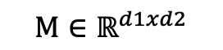
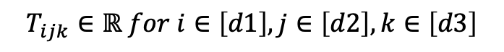
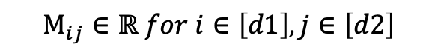
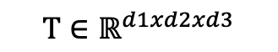
What are Tensors?
M
d1
T
d1
d3
d2
d2
$$Μ∈ℝ^{d1xd2}$$
$$T∈ℝ^{d1xd2xd3}$$
$$Μ_{ij}∈ℝ for i∈\left[d1\right], j∈\left[d2\right]$$
$$T_{ijk}∈ℝ for i∈\left[d1\right], j∈\left[d2\right],k∈\left[d3\right]$$
Notes:
In this talk, i will introducing new class of recurrrent neural networks known as tensor RNNs that have tensor connections

Slide 3
What are Tensors?
M
d1
T
d1
d3
d2
d2
$$Μ∈ℝ^{d1xd2}$$
$$T∈ℝ^{d1xd2xd3}$$
$$Μ_{ij}∈ℝ for i∈\left[d1\right], j∈\left[d2\right]$$
$$T_{ijk}∈ℝ for i∈\left[d1\right], j∈\left[d2\right],k∈\left[d3\right]$$
Notes:
As you can see modern day NNs and variants including CNNs, LSTM, transformers or Autoregressive models have trained parameters or weights that are 2D in nature and are indexed by i,j

Slide 4
What are Tensors?
M
d1
T
d1
d3
d2
d2
$$Μ∈ℝ^{d1xd2}$$
$$T∈ℝ^{d1xd2xd3}$$
$$Μ_{ij}∈ℝ for i∈\left[d1\right], j∈\left[d2\right]$$
$$T_{ijk}∈ℝ for i∈\left[d1\right], j∈\left[d2\right],k∈\left[d3\right]$$
Notes:
However Tensor networks that are often used in many-body physics have higher dimensional units often termed as tensor that are indexed by i,j,k, the order of node decides complexity of tensor

Slide 5
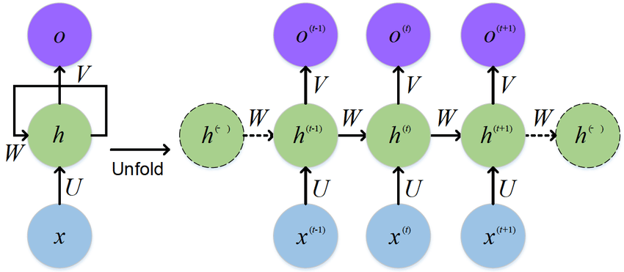
First Order Recurrent Neural Network (RNN)
h = hidden state
x = input symbols
U = input to hidden weights
W = hidden to hidden weights
Input

Slide 6
First Order Recurrent Neural Network (RNN)
Output

Slide 7
First Order Recurrent Neural Network (RNN)
Hidden layers/ state
$h_{i}^{t+1}$ = $σ\left[Ux_{k}^{t}+W_{ij}h_{j}^{t}+b_{i}\right]$ → 1st Order RNN
Notes:
However despite theoretical equivalence these model struggle to go beyond regular languages

Slide 8
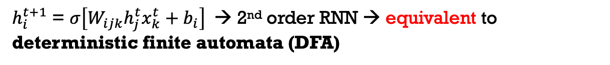
Second Order or Tensor Recurrent neural network (RNN)
Replace W (M) with tensor of order 2
$h_{i}^{t+1}$ = $σ\left[W_{ijk}h_{j}^{t}x_{k}^{t}+b_{i}\right]$→ 2nd order RNN → equivalent to deterministic finite automata (DFA)

Slide 9
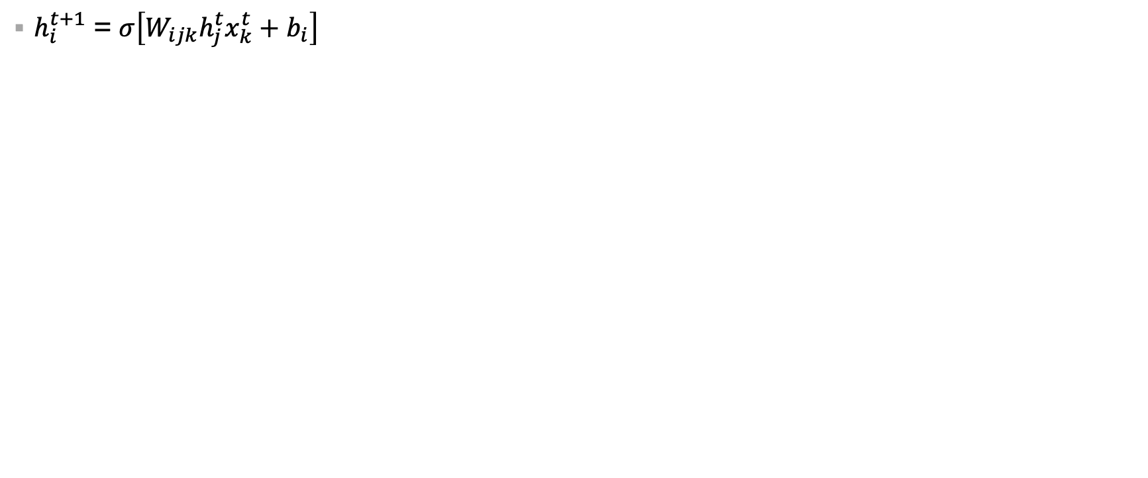
Equivalence between 2nd order RNN and DFA
2nd order or tensor weights
i
j
$h_{i}^{t+1}$ = $σ\left[W_{ijk}h_{j}^{t}x_{k}^{t}+b_{i}\right]$
k
W_{H}
T_{S}
…
h_{t}
h_{t+1}
…
…
S_{t}
S_{t+1}
…
W_{X}
W_{X}
I_{X}
I_{X}
X_{t}
X_{t+1}
X_{t}
X_{t+1}
Update of hidden layer (h) in RNN
State (S) Transition (T) in DFA

Slide 10

How tensor RNNs encode grammars
$h_{i}^{t+1}$ = $σ\left[W_{ijk}h_{j}^{t}x_{k}^{t}+b_{i}\right]$
i = Current state
j = Next state
k = Input neuron

Slide 11
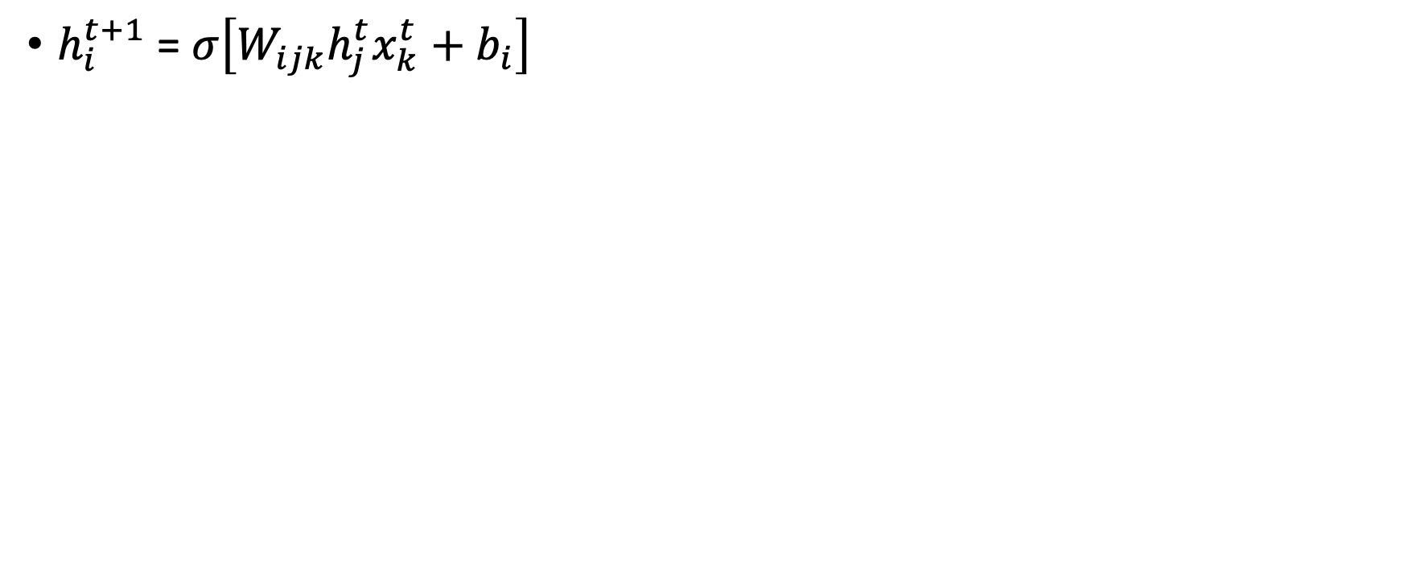
How tensor RNNs encode grammars
$h_{i}^{t+1}$ = $σ\left[W_{ijk}h_{j}^{t}x_{k}^{t}+b_{i}\right]$
i = Current state
j = Next state
k = Input neuron
Encoded model weights (W) interacts with current hidden state (h) to produce future/next hidden representation (h^{t+1}), such that RNN stays close to ideal DFA representation.

Slide 12
How tensor RNNs encode grammars
2nd order RNN will need O(m) state neurons and O(mn) weights
$h_{i}^{t+1}$ = $σ\left[W_{ijk}h_{j}^{t}x_{k}^{t}+b_{i}\right]$
i = Current state
j = Next state
k = Input neuron
Encoded model weights (W) interacts with current hidden state (h) to produce future/next hidden representation (h^{t+1}), such that RNN stays close to ideal DFA representation.

Slide 13
How tensor RNNs encode grammars
2nd order RNN will need O(m) state neurons and O(mn) weights
$h_{i}^{t+1}$ = $σ\left[W_{ijk}h_{j}^{t}x_{k}^{t}+b_{i}\right]$
2mn – m + 3n continuous neurons and no more than m(n^2 + m + 5n -5) + 6n weights = first order RNNs
i = Current state
j = Next state
k = Input neuron
Encoded model weights (W) interacts with current hidden state (h) to produce future/next hidden representation (h^{t+1}), such that RNN stays close to ideal DFA representation.
Learning (Omlin and Giles JACM 96), ongoing work

Slide 14
Third Order or Tensor RNN
Replace W (M) with tensor of order 3
$h_{i}^{t+1}$ = $σ\left[W_{ijkl}h_{j}^{t}x_{k}^{t}a_{l}^{t}+b_{i}\right]$ → 3rd order RNN → equivalent to Push Down Automata with stack

Slide 15
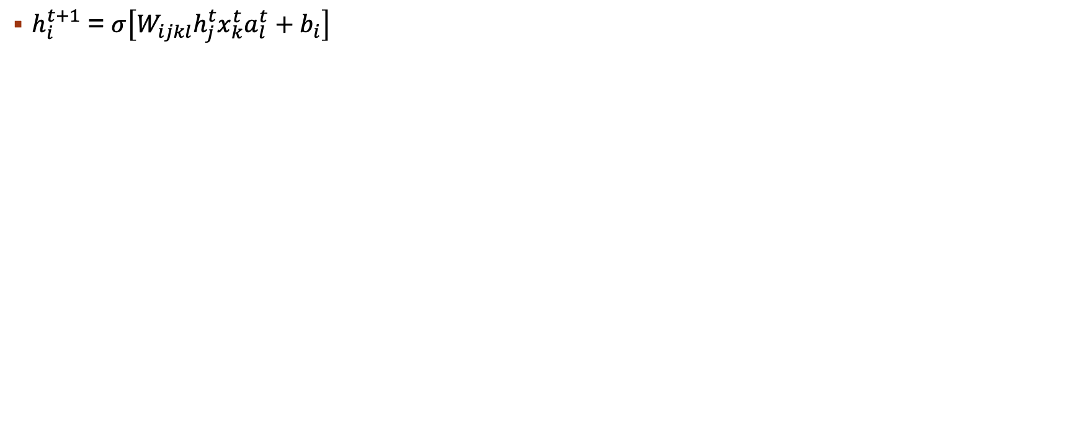
Equivalence between 3rd order RNN and PDA
3rd order or tensor weights
i
j
$h_{i}^{t+1}$ = $σ\left[W_{ijkl}h_{j}^{t}x_{k}^{t}a_{l}^{t}+b_{i}\right]$
k
W_{H}
T_{S}
…
h_{t}
h_{t+1}
…
…
S_{t}
S_{t+1}
…
W_{X}
W_{X}
I_{X}
I_{X}
X_{t}
X_{t+1}
X_{t}
X_{t+1}
Update of hidden layer (h) in RNN
State (S) Transition (T) in DFA

Slide 16

Equivalence between 3rd order RNN and PDA
3rd order or tensor weights
j
$h_{i}^{t+1}$ = $σ\left[W_{ijkl}h_{j}^{t}x_{k}^{t}a_{l}^{t}+b_{i}\right]$
i
k
Stack = PDA
W_{H}
T_{S}
…
h_{t}
h_{t+1}
…
…
S_{t}
S_{t+1}
…
W_{X}
W_{X}
I_{X}
I_{X}
X_{t}
X_{t+1}
X_{t}
X_{t+1}
Update of hidden layer (h) in RNN
State (S) Transition (T) in DFA

Slide 17


Theoretical limitations in recognizing Context Free Languages (CFLS)
Multi-layer perceptron
Convolution neural networks (Resnet..)
Tensor RNNs with memory (NSPDA, NNPDA)
Transformers (BERT)
Recurrent neural networks (LSTM, GRU)
Recurrent neural networks with memory (NTM, Stack-RNN)
Autoregressive models (GPT-3)
Notes:
Since 1960, there have been interest in deriving theoretical capability of neural networks in recognize complex grammars, RNNs have shown to be turing complete including transformers and auto regressive models

Slide 18
Theoretical limitations in recognizing CFLs
Multi-layer perceptron
Convolution neural networks (Resnet..)
Tensor RNNs with memory (NSPDA, NNPDA)
Transformers (BERT)
Recurrent neural networks (LSTM, GRU)
Recurrent neural networks with memory (NTM, Stack-RNN)
Autoregressive models (GPT-3)
Infinite precision and weights
Notes:
However all prior results assume infinite precision and weights to recognize complex grammars, this is impractical and fails to derive true computational power of NNs

Slide 19
Theoretical limitations in recognizing CFLs (Finite precision and weights)
Multi-layer perceptron
Convolution neural networks (Resnet..)
Recurrent neural networks (LSTM, GRU)
Recurrent neural networks with memory (NTM, Stack-RNN)
Transformers (BERT)
Autoregressive models (GPT-3)
Tensor RNNs with memory (NSPDA, NNPDA)
Notes:
In step towards deriving computational limits we show theoretically that class of RNNs we have proposed can recognize any class of PDA with finite precision and bounded weights. To do so we show create a differentiable version of the model

Slide 20
Differentiable stack is equivalent to discrete stack
Push (1)
Pop (-1)
Top
No-op (0)
Real stack = ideal stack
Notes:
Ideally a stack is LIFO datastructure, where top indicates current or recent symbol into the memory, it performs two operations push and pop, no-op refers to no operation, a ideal stack refers to structure which is deterministic and has only one value asscoiated with it

Slide 21
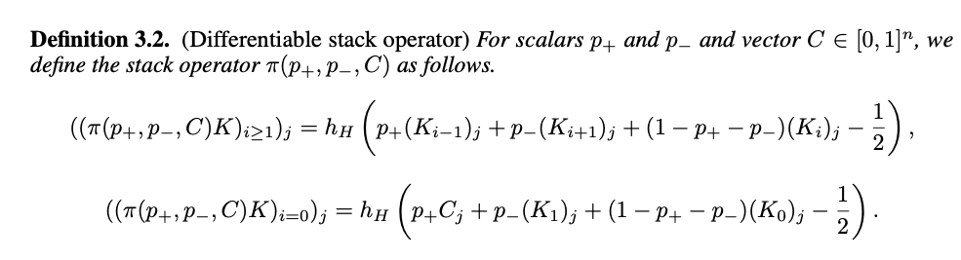
Definition for differentiable stack
Here we define, differentiable stack operator with approximate push, pop and no-op
Stogin and Mali et al., Arxiv ’20
Notes:
In deep learning, work horse algorithm to train NNs in backprop or BPTT, which requires all component of the network to be differentiable, prior work have made assumption that all units are discrete, however we show in this work on challenging sceanrios when you have all differentiable units, there exists a proof. To do so we create a differentiable stack that approximated ideal operations for push/pop and no-op still holds true

Slide 22
Definition for differentiable stack
$∏(0,1,C)$ = Approximate Pop operator
Stogin and Mali et al., Arxiv ’20
Notes:
In deep learning, work horse algorithm to train NNs in backprop or BPTT, which requires all component of the network to be differentiable, prior work have made assumption that all units are discrete, however we show in this work on challenging sceanrios when you have all differentiable units, there exists a proof. To do so we create a differentiable stack that approximated ideal operations for push/pop and no-op still holds true. When I say approximate pop, it means differentiable version of this operator is equivalent to real stack

Slide 23
Definition for differentiable stack
$∏(0,0,C)$ = Approximate Identity operator
Stogin and Mali et al., Arxiv ’20
Notes:
In deep learning, work horse algorithm to train NNs in backprop or BPTT, which requires all component of the network to be differentiable, prior work have made assumption that all units are discrete, however we show in this work on challenging sceanrios when you have all differentiable units, there exists a proof. To do so we create a differentiable stack that approximated ideal operations for push/pop and no-op still holds true

Slide 24
Definition for differentiable stack
$∏(1,0,C)$ = Approximate Push operator
Stogin and Mali et al., Arxiv ’20
Notes:
In deep learning, work horse algorithm to train NNs in backprop or BPTT, which requires all component of the network to be differentiable, prior work have made assumption that all units are discrete, however we show in this work on challenging sceanrios when you have all differentiable units, there exists a proof. To do so we create a differentiable stack that approximated ideal operations for push/pop and no-op still holds true

Slide 25
Differentiable stack is equivalent to discrete stack
Push (0.8)
Pop (0.1)
Top
Differentiable stack approximates ideal stack
No-op (0.02)
Notes:
However this becomes more challenging when using diff stack, since now value lies between [0-1], so 0.6 can indicate push, 0.62, 0.9 and so on and any deviation in gradient trajectory will switch the entire meaning and instead of push model will pop the similar element.

Slide 26
Neuro SYMOBLIC AI: Can we efficiently utilize grammatical rules with NN?
Research Question(s):
How can we use prior knowledge/rules with neural networks (NNs)?
What benefit will this have compared to traditional learning?

Slide 27
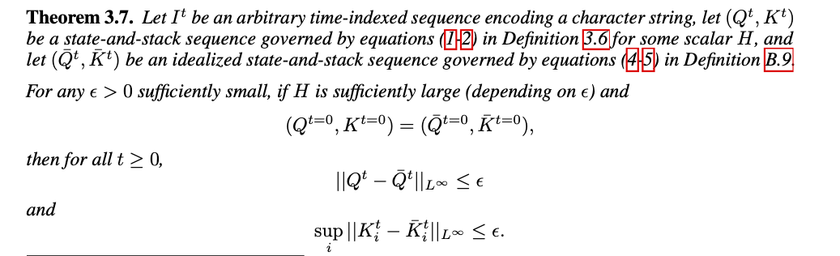
Tensor Network augmented with differentiable stack is equivalent to push Down Automata (PDA)
Stogin and Mali et al., Arxiv ’20

Slide 28
Tensor Network augmented with differentiable stack is equivalent to push Down Automata (PDA)
Tensor network state sequence is approximately equivalent to PDA states
Stogin and Mali et al., Arxiv ’20

Slide 29
Tensor Network augmented with differentiable stack is equivalent to push Down Automata (PDA)
Tensor network stack sequence is approximately equivalent to ideal stack sequence
Stogin and Mali et al., Arxiv ’20

Slide 30
Outcomes
First work to build interpretable model that is theoretically equivalent to pushdown automata
All prior works encode strings/input into the state of RNN, whereas we encode PDA state.
This leads to RNN = PDA for any strings, whereas first-order RNN would require different different RNN for each input

Slide 31
Outcomes
First work to build interpretable model that is theoretically equivalent to pushdown automata
All prior works encode strings/input into the state of RNN, whereas we encode PDA state.
This leads to RNN = PDA for any strings, whereas first-order RNN would require different model for each input
First work to show tensor RNNs or any type of neural network with finite weight and bounded precision can recognize any class of push down automata (PDA)

Slide 32
Outcomes
First work to build interpretable model that is theoretically equivalent to pushdown automata
All prior works encode strings/input into the state of RNN, whereas we encode PDA state.
This leads to RNN = PDA for any strings, whereas first-order RNN would require different model for each input
First work to show tensor RNNs with finite weight and bounded precision can recognize any class of push down automata (PDA)
First work to show equivalence with PDA with differentiable stack

Slide 33
Outcomes
First work to build interpretable model that is theoretically equivalent to pushdown automata
All prior works encode strings/input into the state of RNN, whereas we encode PDA state.
This leads to RNN = PDA for any strings, whereas first-order RNN would require different model for each input
First work to show tensor RNNs with finite weight and bounded precision can recognize any class of push down automata (PDA)
First work to show equivalence with PDA with differentiable stack
First work to show upper bound for number of neurons required to construct Tensor RNNs to recognize any PDA.
For a state machine with n states, input alphabet of size m1, a stack alphabet of size m2, and a stack with maximum capacity s, our algorithm can construct a sparse recurrent network with O(n) state neurons, O(m1m2n(m1 + m2 + n)) weights and a stack memory footprint of size O(sm2) to approximate any PDA.

Slide 34
Stability of NNPDA
Stogin and Mali, arXiv ‘20
This proves that NNPDA is equivalent to PDA.
First work to show computational power of RNNs with finite precision and weights (PDA)
For a state machine with n states, input alphabet of size m1, a stack alphabet of size m2, and a stack with maximum capacity s, our algorithm can construct a sparse recurrent network with O(n) state neurons, O(m1m2n(m1 + m2 + n)) weights and a stack memory footprint of size O(sm2) to approximate any PDA.

Slide 35
Empirical Performance ON CFLs
Multi-layer perceptron
Convolution neural networks (Resnet, VGG)
Recurrent neural networks (LSTM, GRU)
Transformers (BERT)
Autoregressive models (GPT-3)
Tensor RNNs with memory (NSPDA, NNPDA)
Few Recurrent neural networks with memory (NTM,Diff-stackMRNN)
Notes:
However to deploy these systems in real world scenario, it is important to understand learning capability and computational power of these kind of structure

Slide 36
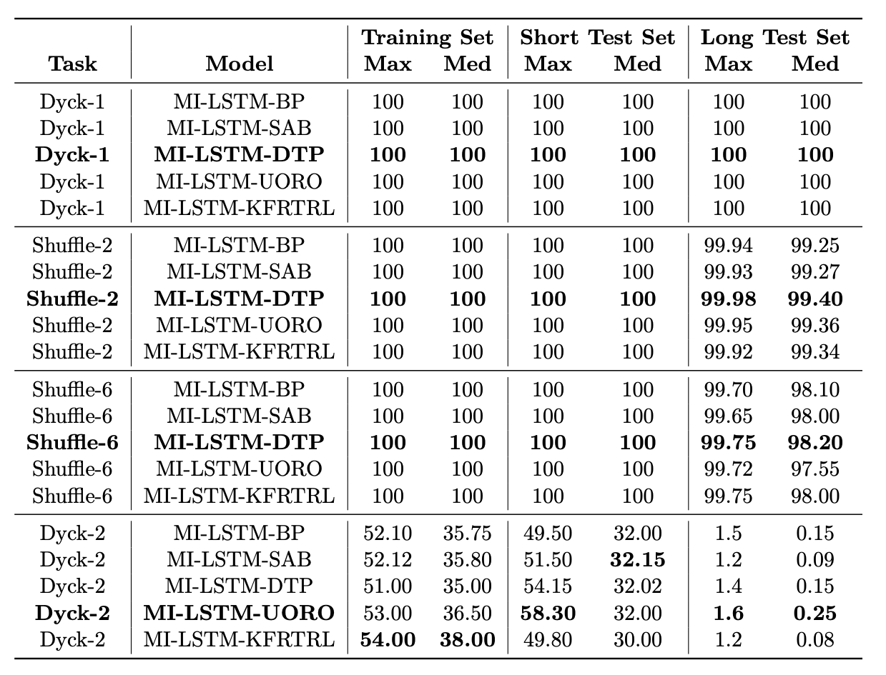
RNNs on Context free Languages
First-order RNNs are good at recognizing regular grammars.
Mali et al., ICGI ’21b
Notes:
In NLP, it has seen that RNN based variants and even transformers dominating the field, why we need memory augmented NNs or Tensor NNs
You cannot increase memory without increasing size of the model, and on complex grammars such as parenthesis memory requirements increases exponentially as depth of the grammar is increased.
Second argument often researchers make is that are not trained correctly and learning algorithms might be the issues in failure of these model.
To this end we conducted experiments with wide variety of learning algorithms

Slide 37
RNNs on Context free Languages
First-order RNNs are good at recognizing regular grammars.
Complex grammars such as CFGs require memory.
Upcoming work:- Computational power of transformers, model with even 20M parameters struggle to recognize longer sequences.
Mali et al., ICGI ’21b
Notes:
Theoretical findings hold true, this is even true for transformers in our upcoming work we found that 20million parameter model fails when learning complex grammars compared to 1.2M memory augmented model.

Slide 38
Towards Neuro-Symbolic AI
Can we use prior knowledge to facilitate learning?
Notes:
To this end my work, is focused on designing neuro symbolic AI module that asnwers following questions but at the same time are interpretable and fair

Slide 39
Towards Neuro-Symbolic AI
Can we use prior knowledge to facilitate learning?
Can we learn structure from data?

Slide 40
Towards Neuro-Symbolic AI
Can we use prior knowledge to facilitate learning?
Can we learn structure from data?
Can we create model that learns from less data and generalizes well?

Slide 41
Towards Neuro-Symbolic AI
Can we use prior knowledge to facilitate learning?
Can we learn structure from data?
Can we create model that learns from less data and generalizes well?
Can we create an interpretable model that matches black box model performance?

Slide 42
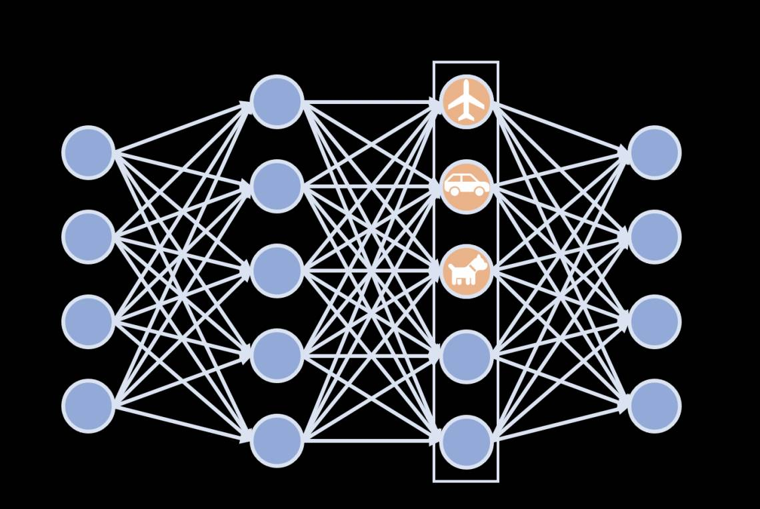
Towards Rule Based System
Input
Output
Notes:
For example, as pointed out earlier NNs are optimized to achieve better accuracy often with a cost of explain ability and requires huge compute and data to learn these features.

Slide 43
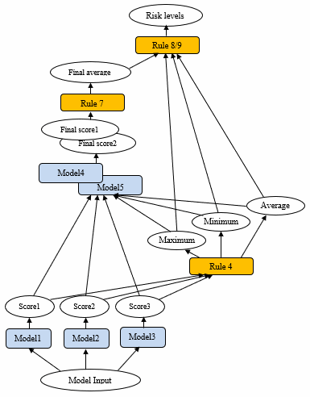
Towards Rule Based System
Input
Output
Notes:
Second we have rule based system, that are interpretable and can learn from limited data, but as distribution is increased complexity increases and often rules are unknown

Slide 44
Towards Rule Based System
Input
Output
Notes:
Here we are trying to combine benefit of these two models and create models that can be used for social good

Slide 45
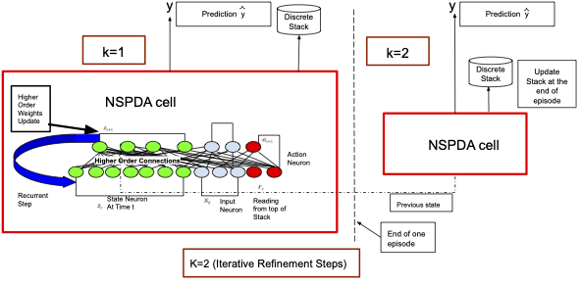
Neural State PDA (NSPDA)
Tensor weights have partial rules
Mali et al., IEEE TAI ’21
Notes:
I encode partial rules into this framework, in other words I add production rule and let neural network figure out further search trajectory, when we visualize the rules generated by this network, it is identical to ones available in grammars. Guided learning

Slide 46
Neural State PDA (NSPDA)
NSPDA cell acts as a controller
Mali et al., IEEE TAI ’21
Notes:
Now this partial encode state acts as a controller and controls the memory, one can check equivalence between number of push/pop operations performed by model compared with traditional PDA

Slide 47
Neural State PDA (NSPDA)
Memory
Mali et al., IEEE TAI ’21

Slide 48
Contributions
First model to integrate complex grammar production rule(s) into tensor RNNs augmented with stack

Slide 49
Contributions
First model to integrate complex grammar production rule(s) into tensor RNNs augmented with stack
First to extend tensor RNNs w/ modern gradient based learning algorithms
Forward propagation (RTRL, UORO), local gradients with backward propagation (DTP), backward propagation (BPTT, TBPTT, SAB)

Slide 50
Contributions
First model to integrate complex grammar production rule(s) into tensor RNNs augmented with stack
First to extend tensor RNNs w/ modern gradient based learning algorithms
Forward propagation (RTRL, UORO), local gradients with backward propagation (DTP), backward propagation (BPTT, TBPTT, SAB)
Rule or automata extracted from tensor RNNs are equivalent to minimal PDA for source grammar

Slide 51
Contributions
First model to integrate complex grammar production rule(s) into tensor RNNs augmented with stack
First to extend tensor RNNs w/ modern gradient based learning algorithms
Forward propagation (RTRL, UORO), local gradients with backward propagation (DTP), backward propagation (BPTT, TBPTT, SAB)
Rule or automata extracted from tensor RNNs are equivalent to minimal PDA for source grammar
Model is interpretable by design and visualization, verifiable via extraction

Slide 52
Contributions
First model to integrate complex grammar production rule(s) into tensor RNNs augmented with stack
First to extend tensor RNNs w/ modern gradient based learning algorithms
Forward propagation (RTRL, UORO), local gradients with backward propagation (DTP), backward propagation (BPTT, TBPTT, SAB)
Rule or automata extracted from tensor RNNs are equivalent to minimal PDA for source grammar
Model is interpretable by design and visualization, verifiable via extraction
Requires less training data & neurons to generalize over longer sequences
Long Short Term Memory (LSTM) with 4096 neurons & 3 layers fails to recognize CFGS compared to NSPDA w/ only 8 neurons.
Transformers with 3X more parameters also has similar issues, in some cases even worse (ongoing).

Slide 53
NSPDA compared with other memory models
Rule insertion gives hints that improves generalization
Model learns to push and pop
Requires only 8 neurons and 2000 samples to converge, generalizes on unseen data

Slide 54
NSPDA compared with other memory models
Rule insertion gives hints that improves generalization
On parenthesis LSTM = 2%, Neural Stack = 95%, DNC = 97%, NSPDA = 99.2%
Mali et al., IEEE TAI ’21
Notes:
As you can see from results, memory is important, which is shown by other first order RNNs augmented with Memory, however prior knowledge encoded in our work shows how a model can generate stable predictions across grammars and at the same time beat or be comparable to SOTA

Slide 55
NSPDA compared with other memory models
Rule insertion gives hints that improves generalization
On parenthesis LSTM = 2%, Neural Stack = 95%, DNC = 97%, NSPDA = 99.2%
Mali et al., IEEE TAI ’21

Slide 56
NSPDA compared with other memory models
Rule insertion gives hints that improves generalization
Model learns to push and pop
Requires only 8 neurons and 2000 samples to converge, generalizes on unseen data

Slide 57
NSPDA compared with other memory models
Rule insertion gives hints that improves generalization
Model learns to push and pop
Requires only 8 neurons and 2000 samples to converge and generalize on unseen data

Slide 58
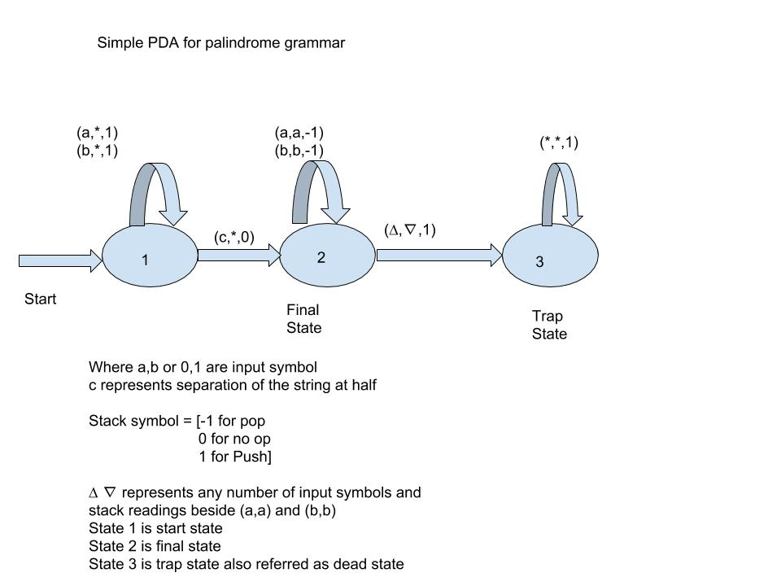
A simple PDA for palindrome recognition
Push to the top of the stack
Stack

Slide 59
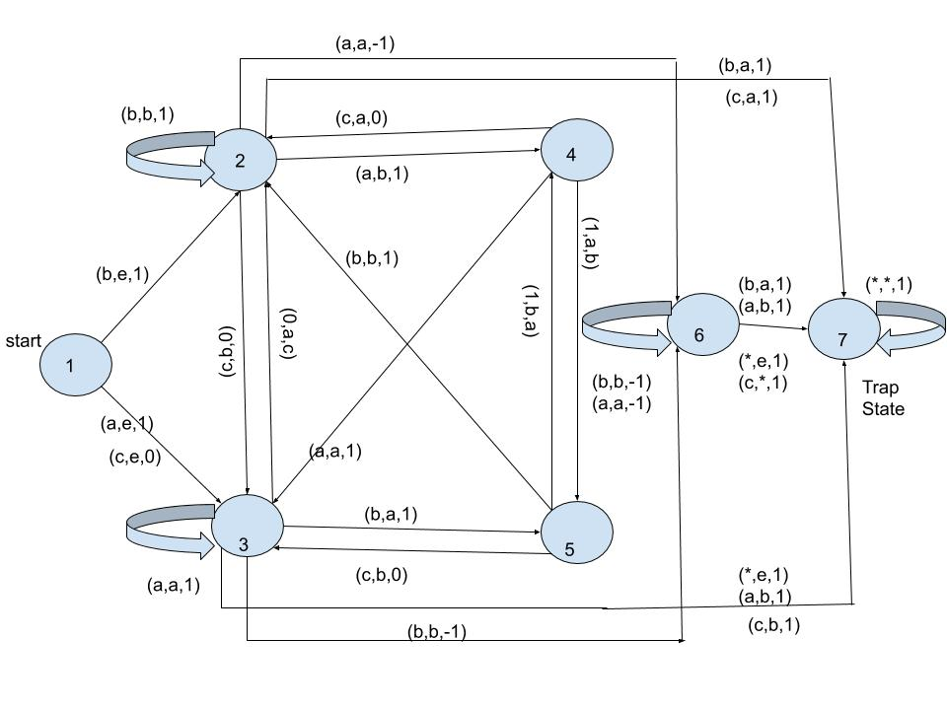
Extracted PDA for palindrome grammar using Designed NSPDA
Using Hopcroft algorithms we can get minimal PDA
Work in progress
Notes:
As a mentioned model requires 7-8 neurons to learn, this is the extracted PDA

Slide 60
A simple PDA for palindrome recognition
Push to the top of the stack
Stack
Pop from the top of the stack
Very few states
needed to control stack

Slide 61
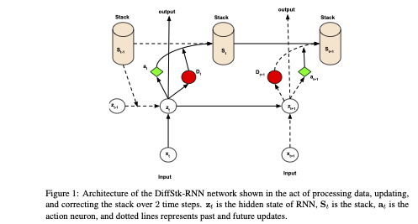
DiffStk-RNN Architecture
External Memory
RNN as Controller
Can we further reduce complexity without sacrificing interpretability
Mali et al., ICGI ‘21
Notes:
Tesnor RNNs or computationally efficient when evalueted based on number of parameters, training time, total number of samples needed to converge leading to faster convergence, but due to there higher dimensional nature, it gets challenging to scale them on lage scale datasets, to this end we design rank-1 approximation of tensor weights and proposed new architecture known as diff-stk RNN, given we propose rank-1 approximation our approach can work with many modern day RNNs including LSTM, GRU. As you can see in this work we use differentiable stack and entire system is end-to-end differentiable where RNN acts as controller controlling stack

Slide 62
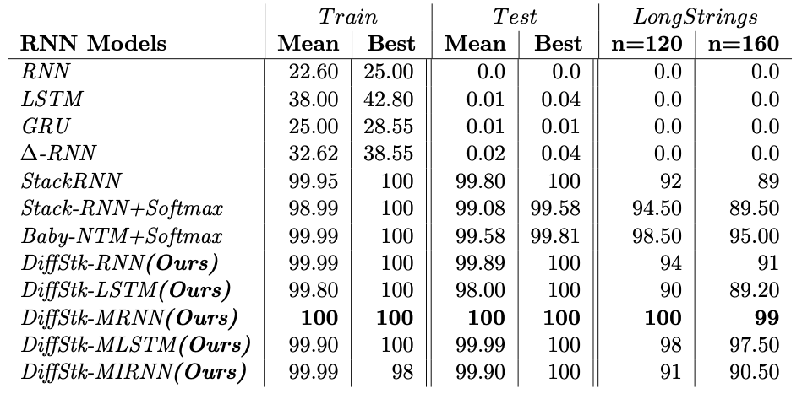
Tensor RNNs have stable performance even for very long strings
Higher order or tensor RNNs produces stable performance even for very long strings
Results are consistent when models are trained and tested on task such as language modeling and multi-modal
Mali et al., ICGI ‘21

Slide 63
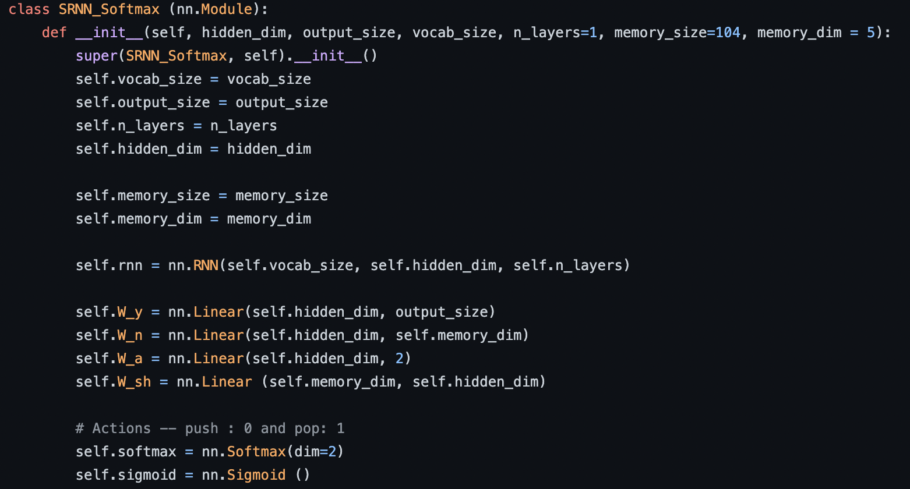
Define stack class
You can replace RNN with LSTM, GRU or Tensor RNNs

Slide 64
Define stack class
Define stack specific hyperparameters

Slide 65
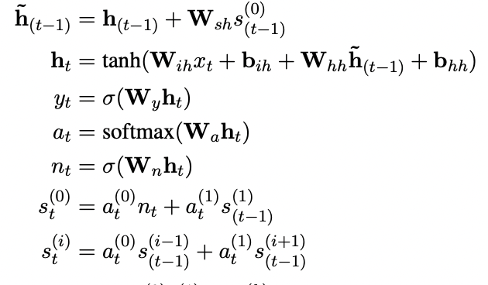
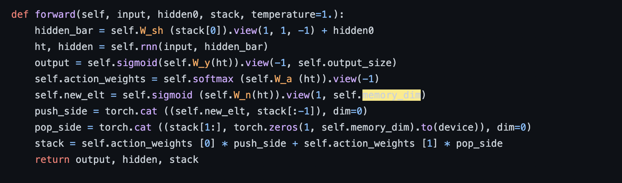
Some code how it works

Slide 66
Tensor Tree RNN
Designed first tensor recursive recurrent neural network with & without external memory for mathematical reasoning → Extending Tree NN with higher order connections
Mathematical expressions are context free languages → Dyck languages
Mali et al., AAAI ‘21
Notes:
We also evaluated our approach with various representation and much more challenging datasets for mathematical reasoning, recent studies have shown that transforemrs are good in learning these reasoning task when trained and tested on similar districution, but when distribution changes they fail. In this work we show that our model does not struggle with such issues and extrapolate to harder instances and go beyond distribution.

Slide 67
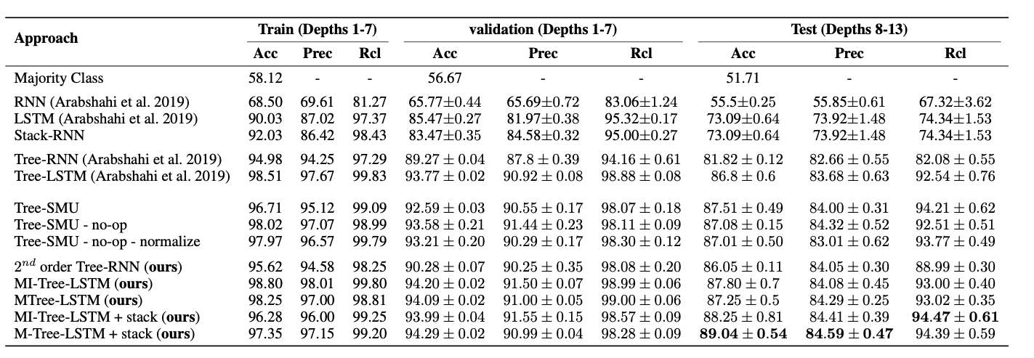
Equation verification for tensor tree RNNs
Mali et al., AAAI ‘21

Slide 68
Equation verification for tensor tree RNNs
For depth = 2 (train) and 4/5 (test)
LSTM = 34.5%
M-Tree-LSTM + Stack = 98%
Mali et al., AAAI ‘21

